Slide 1
EC504 Project Proposal
Ziyan Chen zychen02@bu.edu
Blablabla

Slide 2
Contents
Tree Algorithms and applications
Start from what we’ve learned:
Binary Tree, Balanced Tree
Red-Black tree
B-Tree
Monta Carlo Tree Search
When there are more than 2 children:
KD-Tree
Special cases: Quad-Tree, Oct-Tree, (and probably 2^n Tree)
When things go to linear:
Fusion Tree
Van Emde Boas Tree

Slide 3
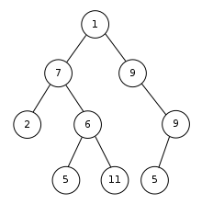
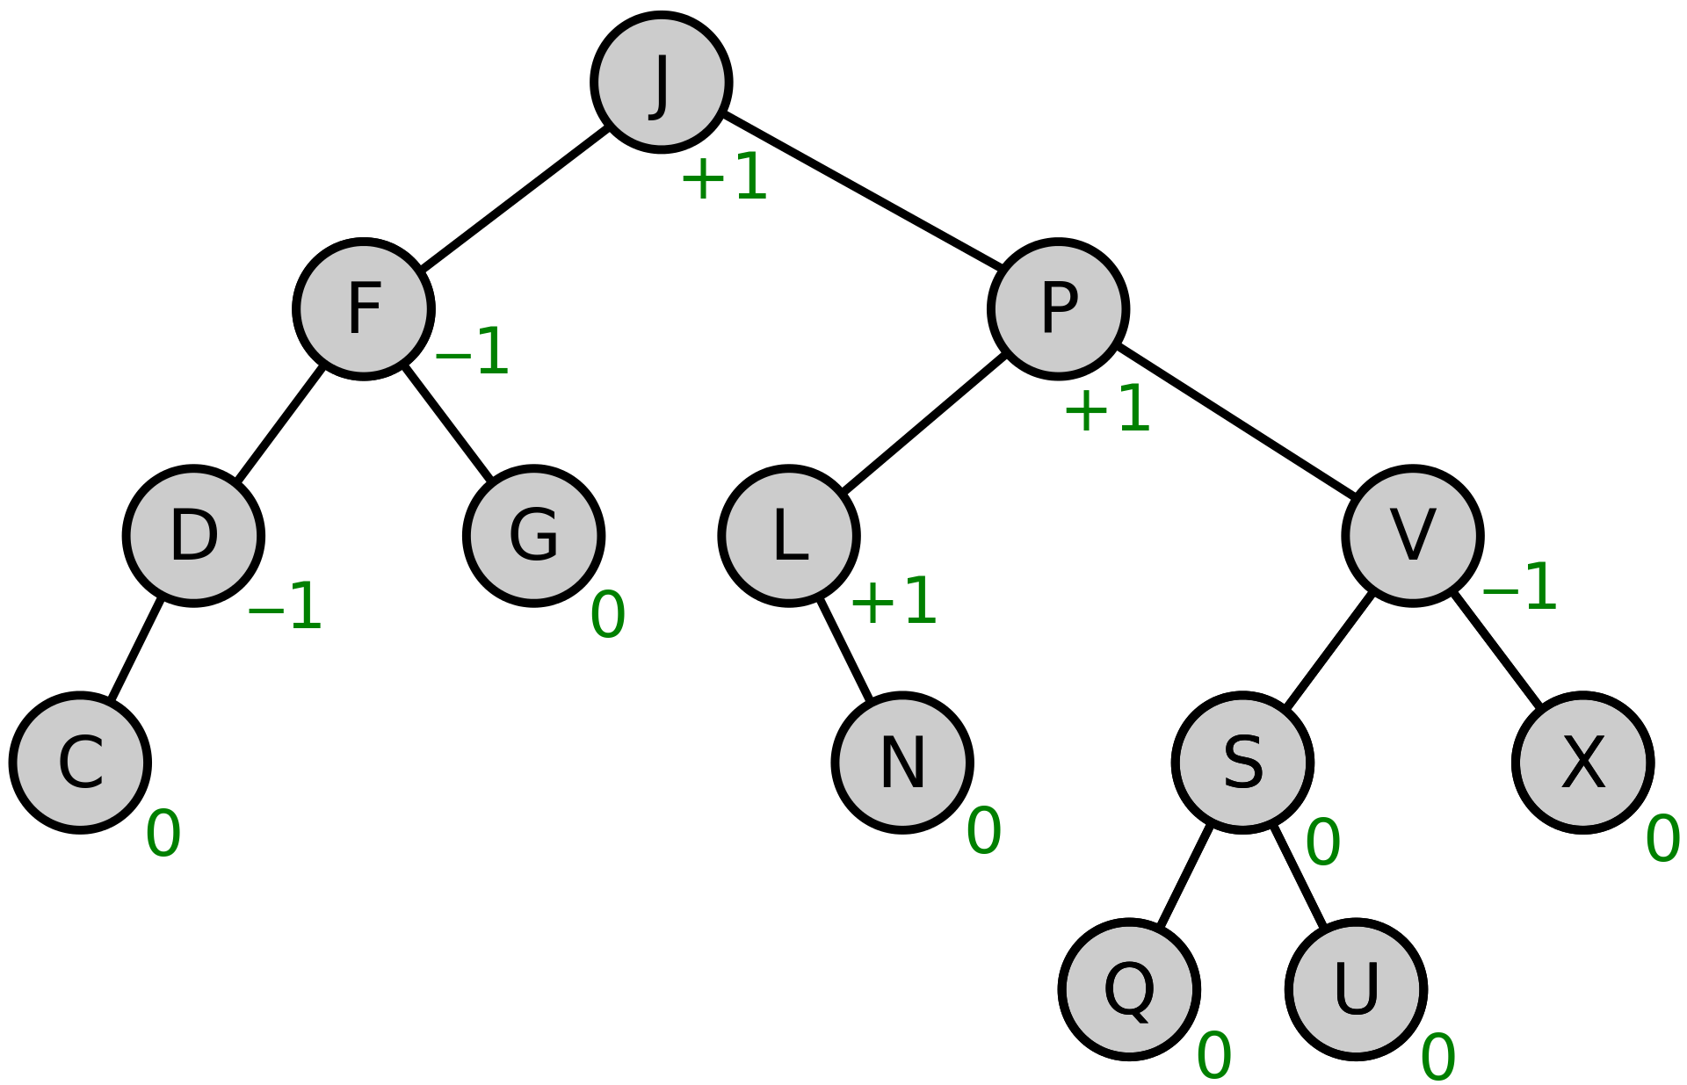
Start from what we’ve learned

Slide 4
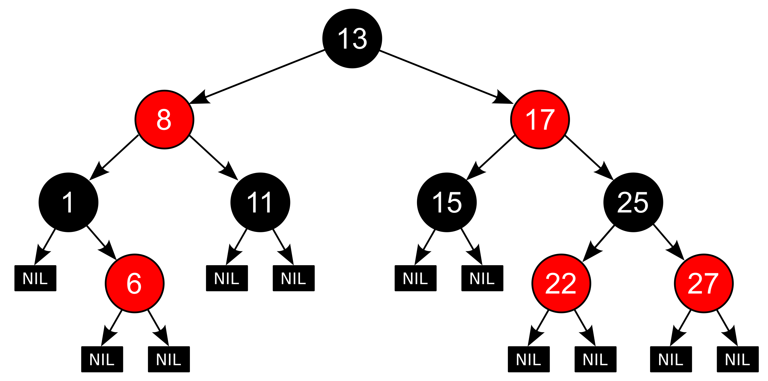
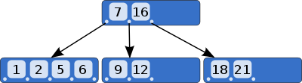
Start from what we’ve learned

Slide 5
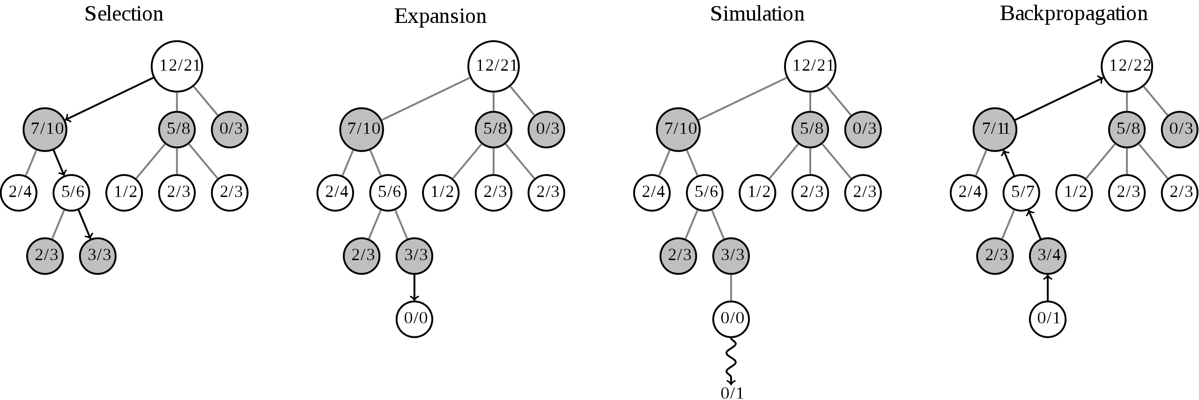
Start from what we’ve learned

Slide 6
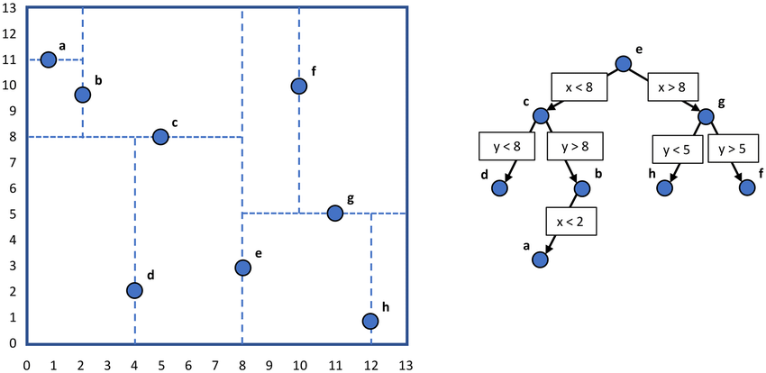
When there are more than 2 children: k-d tree

Slide 7
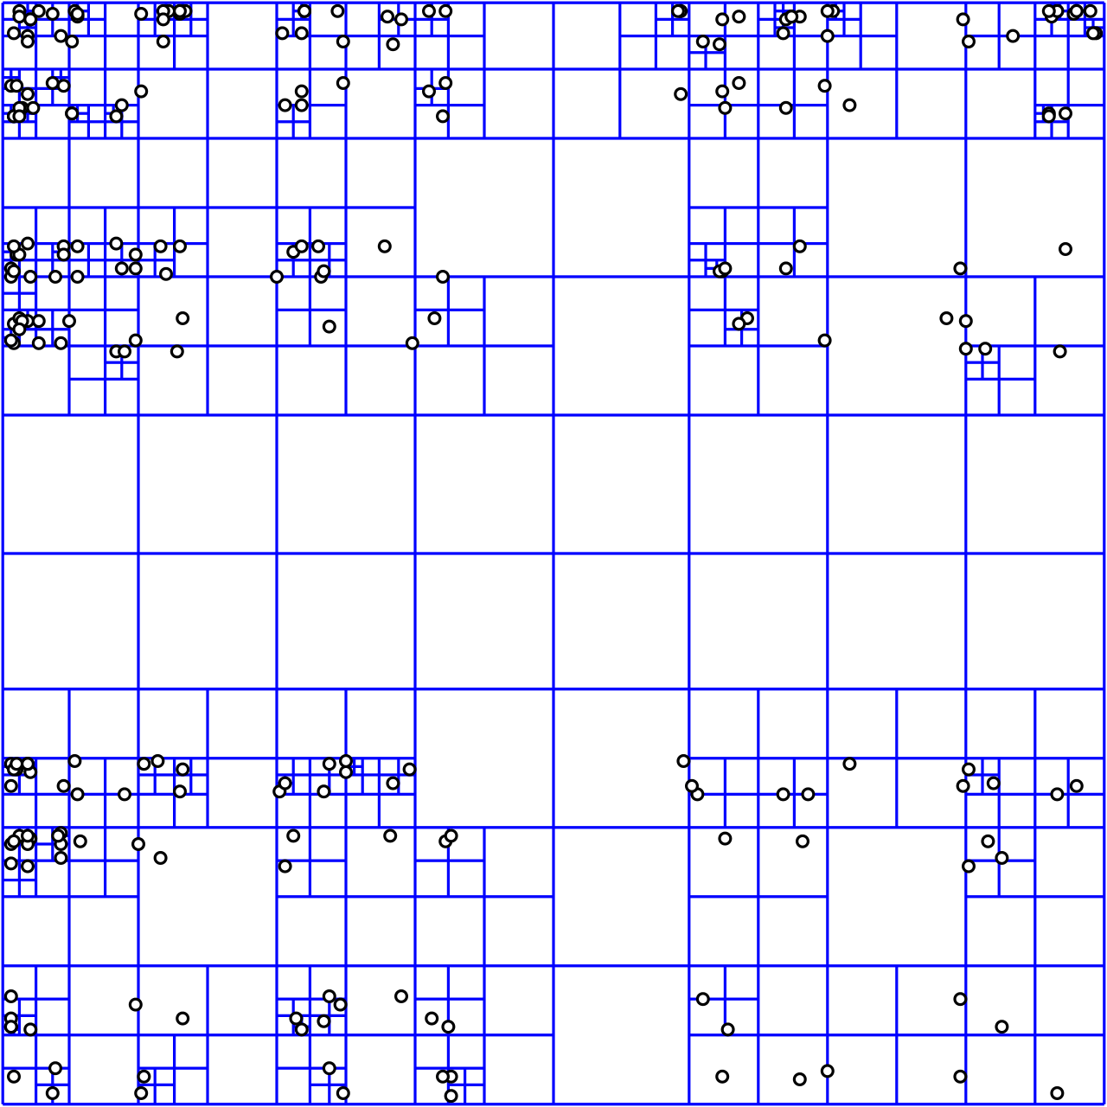
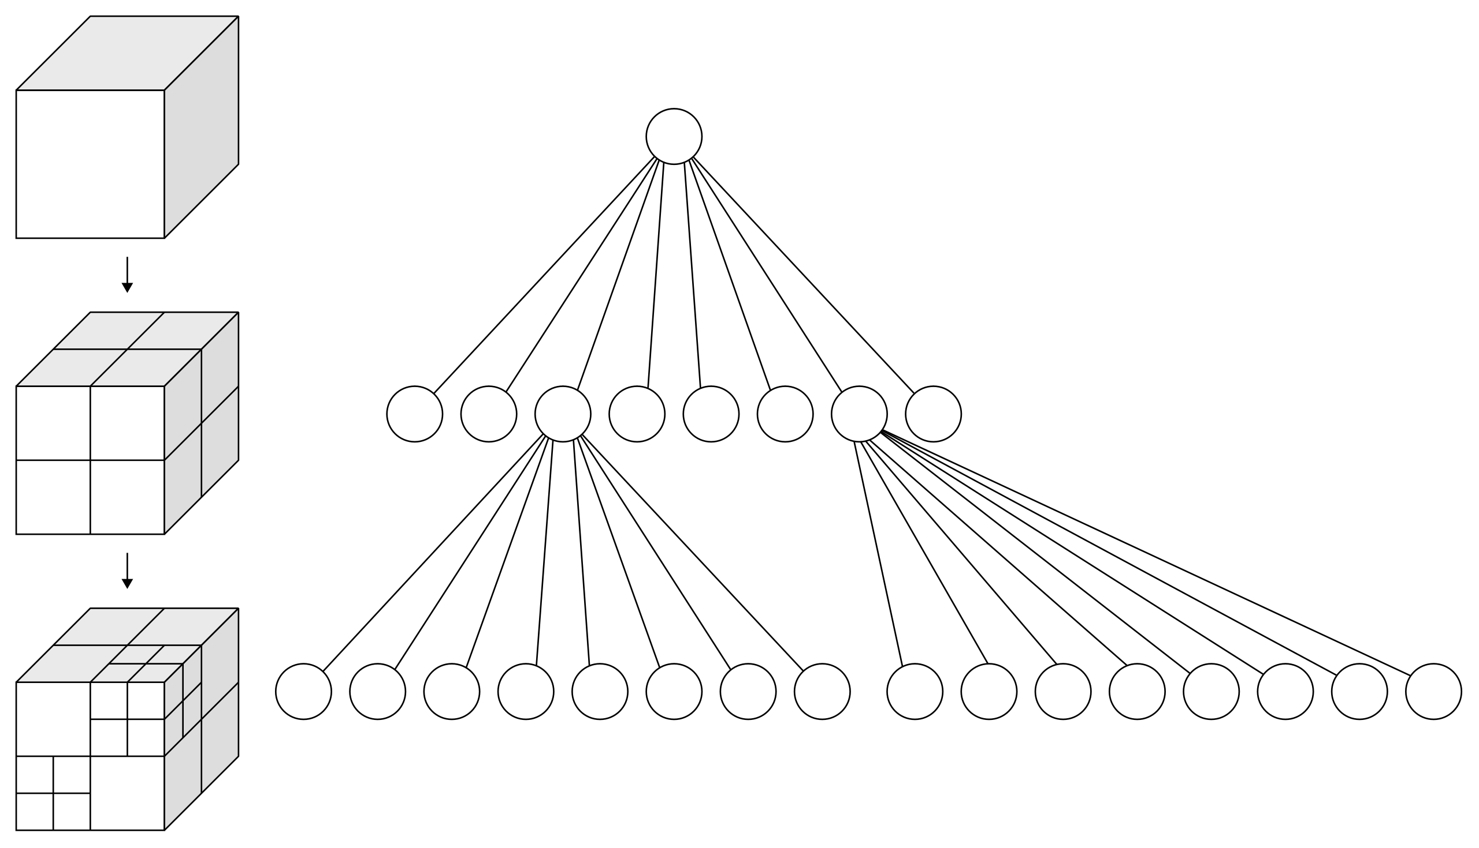
Special cases: Quad-Tree, Oct-Tree

Slide 8
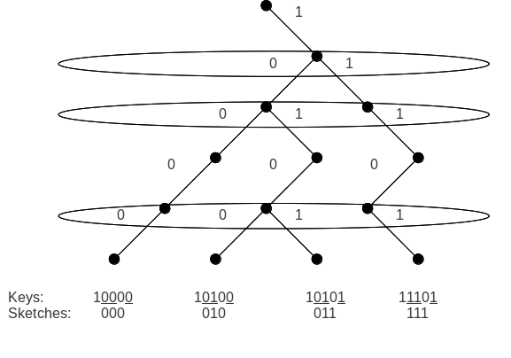
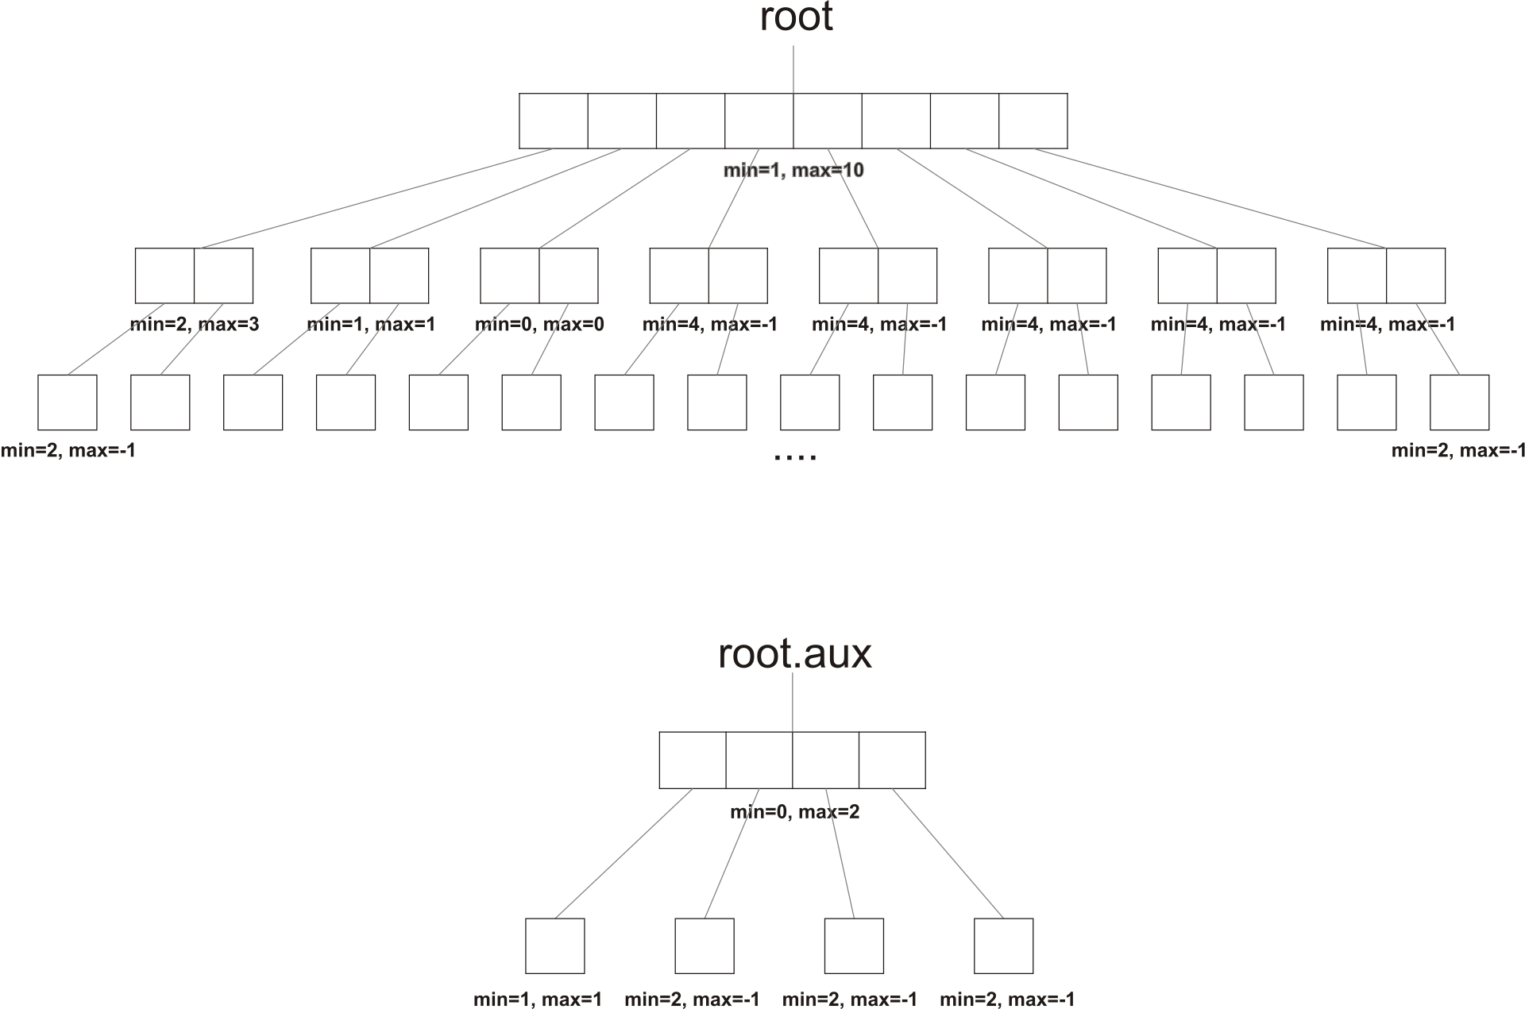
When things go to linear

